Slide 1

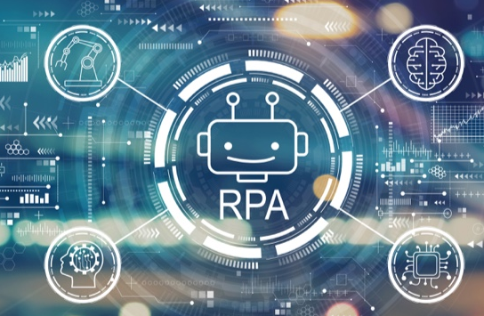
SEMINAR (17CSS86)
TOPIC : ROBOTIC PROCESS AUTOMATION IN BANKING SECTOR
UNDER THE GUIDANCE OF :
MRS. GEETHA PAWAR
ASST. PROFESSOR, DEPT OF CSE
PRESENTED BY: POORNIMA S (1RG17CS036)

Slide 2
ABSTRACT
Robotic Process Automation (RPA) is a useful tool for the pressing demand of the banking sector. The virtual workforce has successfully helped banks to minimize in many cases, eliminate human intervention to a large extent in the execution of earlier human labor heavy tasks. The financial benefits of robotics in banking are matched by the improvement it yields in both back-office processes and the customer experience. The study focuses on factors influencing customer experience in banking services delivered by RPA. Specifically, the study theorizes the role of various factors influencing the adoption of RPA in the banking industry. Results highlight that factors such as security, privacy, reliability and usefulness are significant in advancing RPA in the retail banking industry. Implications for research and practice are also discussed.

Slide 3
INTRODUCTION
WHAT IS RPA?
An entity which is capable of being programmed by a computer for doing complex tasks is known as a robot .In terms of RPA, this task would be to mimic the human actions.
A sequence of steps, that lead to a meaningful activity or task is know as process.
When task happens automatically i.e. without human intervention.
ROBOTIC
RPA
PROCESS
AUTOMATION

Slide 4
INTRODUCTION
Robotic process automation (RPA) is a software technology that makes it easy to build, deploy and manage software robots that emulate humans actions interacting with digital systems and software.
Robotic Process Automation is a useful tool for the pressing demand of the banking sector. Operation costs have been one of the focus areas in the banking sector.
RPA in the banking sector has significantly helped to reduce the costs by 30 per cents to 70 percent, saves labor costs ,operational efficiency, accuracy, 24/7, offer innovative services and better experience of the customer.
RPA is being increasingly used as a tool to automate, scale-up, manage, analyze, and provide superior customer service.
Leading banks in India, such as ICICI Bank, HDFC Bank, and Axis Bank, have implemented Robotic Process Automation.
Banks use RPA to perform repetitive tasks like data entry and to automate customer service and back-office workflows. RPA can also be supplemented with AI and Machine Learning (ML) to handle sophisticated processes with higher accuracy and efficiency.

Slide 5
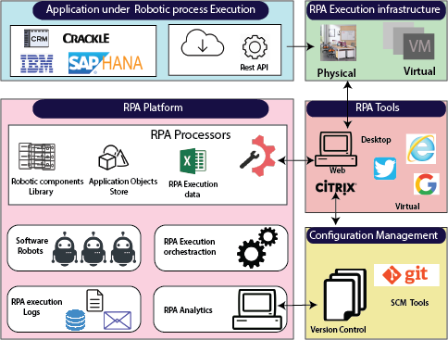
RPA ARCHITECTURE

Slide 6
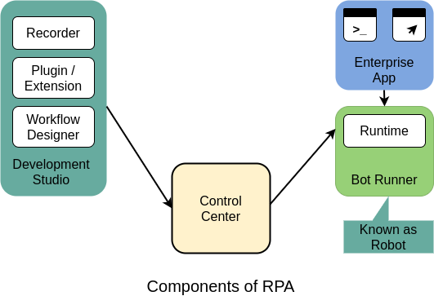
COMPONETS OF RPA

Slide 7
IMPLEMENTATION
Stage-1
Stage-3
Stage-4
Stage-2
Acess for RPA Opportunities
Vendor selection
Capture Process Steps, Pilot and implement
Manage RPA cycle

Slide 8
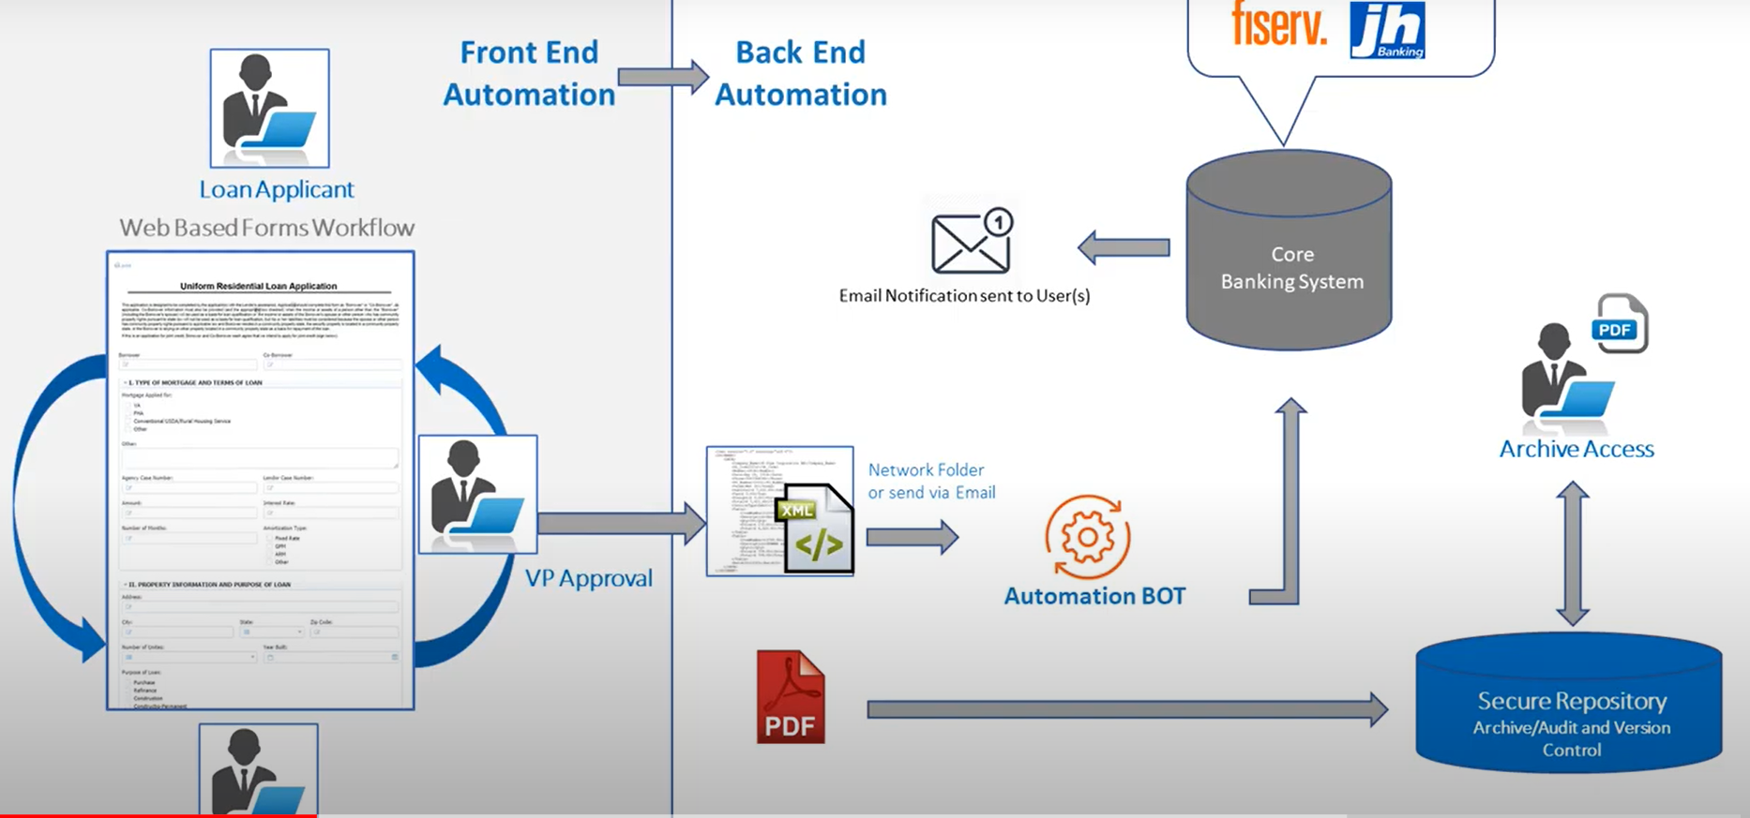
LOAN PROCESSING USING RPA

Slide 9
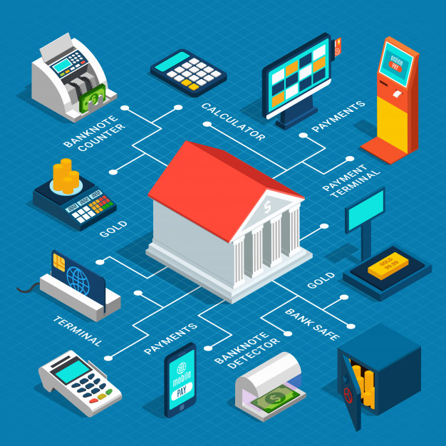
USE CASES IN BANKING
Accounts Payable
Credit card processing
Fraud Detection
KYC process
Report Automation
Mortgage processing
Loan processing
Customer service
Cheque processing
Compliance

Slide 10
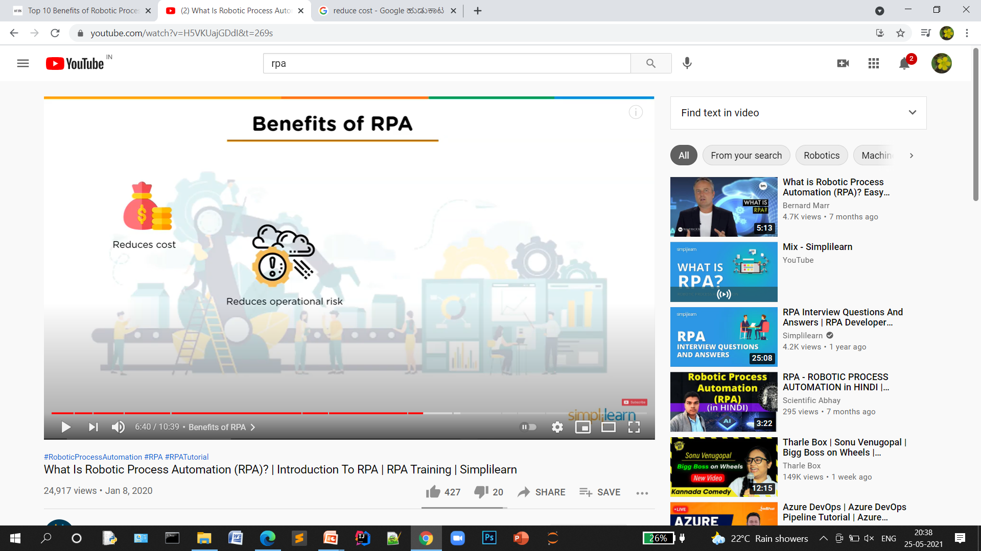







BENEFITS OF RPA IN BANKING
Reduces cost | Faster speeds | Increased accuracy | Consistency
Increased Customer Satisfaction | Security | Fraud detection | Increased operational efficiency

Slide 11




RPA TOOLS
RPA tools are the software that helps users to configure various tasks to get automated.

Slide 12
CONCLUSION
The Robotic Process Automation technology is beneficial to many industries. Robotic Process Automation (RPA) is fast emerging as a highly efficient way to help banking and financial institutions support their digital transformation initiatives. Robotic Process Automation helps as reduced error rates, saves labor costs and operational efficiency, accuracy, and improved efficiency for significant growth in the banking sector. Robotic Process Automation is already being implemented in many banks of the world.

Slide 13
REFERENCES
The Future of Robotic Process Automation (RPA) in the Banking Sector for Better Customer Experience April 2020 Shanlax International Journal of Commerce 8(2):61-65
“10 ways Robotic Process Automation can improve the Loan Origination Process.” Nelito, 2019, https://www.nelito.com/blog/10-ways- Robotic-Process-Automation-can-improve - the-Loan-Origination-Process.html.
Anagnoste, S. (2017). Robotic Automation Process - The next major revolution in terms of back-office operations improvement. Proceedings of the International Conference on Business Excellence, 11(1), 676–686 https://doi.org/https://doi.org/10.1515/picbe-2017-0072
“RPA for Banking.” SmartRPA, https://smartrpa. com/rpa-for-banking

Slide 14
THANK YOU

